Slide 1
HIPAA
What you may not know...Compliance Audits that could end your business!
Strategic Planning and the Importance of Risk Analysis, Polices and Procedures and Electronic Health Records.
Presenters:
James McAllister, Abrams Security
Barry Pollack, Therap Services

Slide 2
Barry Pollack Therap Services, Regional Director
34 years in the I-DD & Behavioral Health Industry
20+ years in Executive Leadership
Providing Solutions for Service Providers

Slide 3
James McAllister, CISA, QSA, PCIP Director of Compliance and Consulting Services
28 years in IT Management
Past 7 years focused on compliance
Specializing in HIPAA and PCI

Slide 4
Introduction
Therap Services is a Secured, SaaS, Web-Based, CCHIT Certified-HIPAA compliant Documentation, Communication, Billing and Reporting solution for Organizations Supporting People with Intellectual & Developmental Disabilities and others.
Therap is the National Leader in the industry:
Organizations in 48 states
5 Mandated Statewide Systems
10 State Contracts
Counties, MCOs and Multi-State Providers
1,300+ Providers
250,000+ Individual Users
500,000+ Individual Records
Endorsed/Supported by CARF, ANCOR, CDS and State Provider Associations across the US

Slide 5
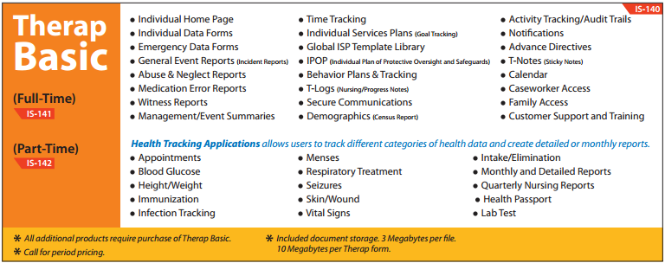
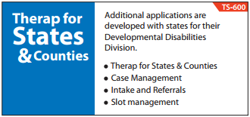
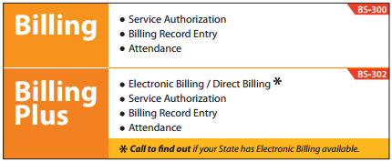
Modules

Slide 6
Why EHRs - Why Therap?
Compliance (Medicaid, State, Accreditations…)
Efficiency (Staff & Financial Resources)
Real Time Communication & Documentation
Outcome Management
Quality Care
Quality Improvement
HIPAA-HITECH-ARRA: Omnibus Act

Slide 7
Not All EHRs Are Created Equal!
Secure Login Profiles:
– Allowing Access to only individuals served
– Allowing Access to only Privileged PHI
Encrypting communications and preventing disclosure to non-privileged individuals
Mobile Documentation does not allow any data to reside on the device
Activity Tracking of all staff and activities

Slide 8
Certification Commission for Health Information Technology
Certified EHR for Clinical Functionality,
Interoperability and Security
© Copyright Therap Services, LLC. 2003 - 2014, All Rights Reserved. U.S. Patents #8281370, #8528056, #8613054, #8615790, #8739253

Slide 9
SOC2 Audit completed for tests on controls that measure:
Service Organization Controls SOC2
Confidentiality
Data Integrity
Processing Integrity
System Security
Physical Security
Change Control
System Operations
Anti-Virus Systems
Data Communications
© Copyright Therap Services, LLC. 2003 - 2014, All Rights Reserved. U.S. Patents #8281370, #8528056, #8613054, #8615790, #8739253

Slide 10
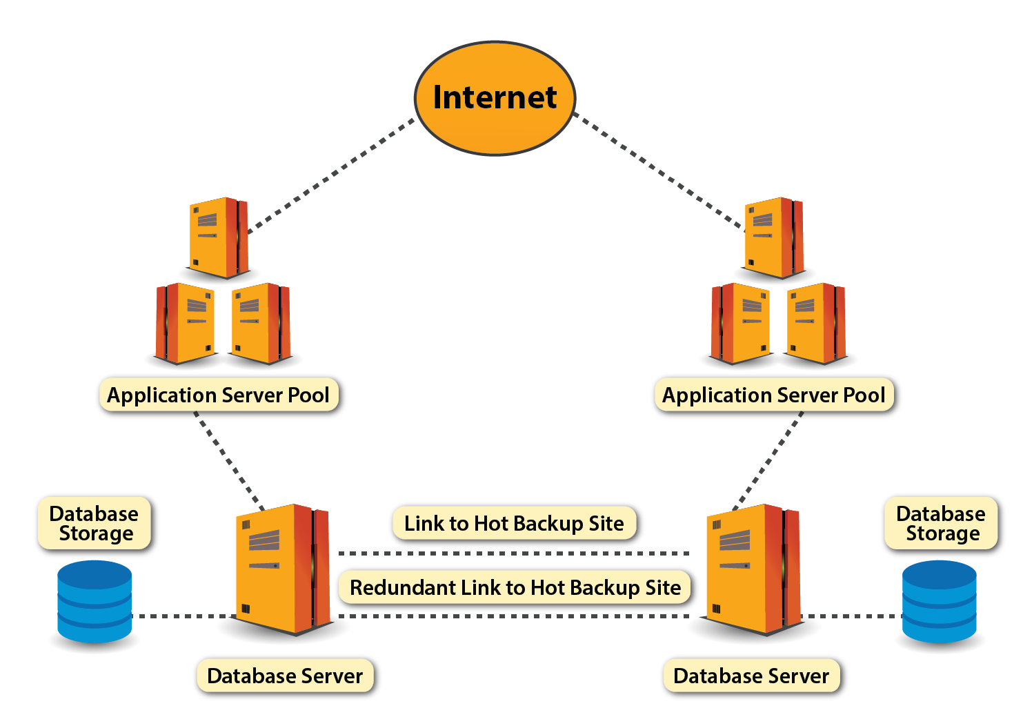
Disaster Recovery
Business Continuity
© Copyright Therap Services, LLC. 2003 - 2014, All Rights Reserved. U.S. Patents #8281370, #8528056, #8613054, #8615790, #8739253

Slide 11
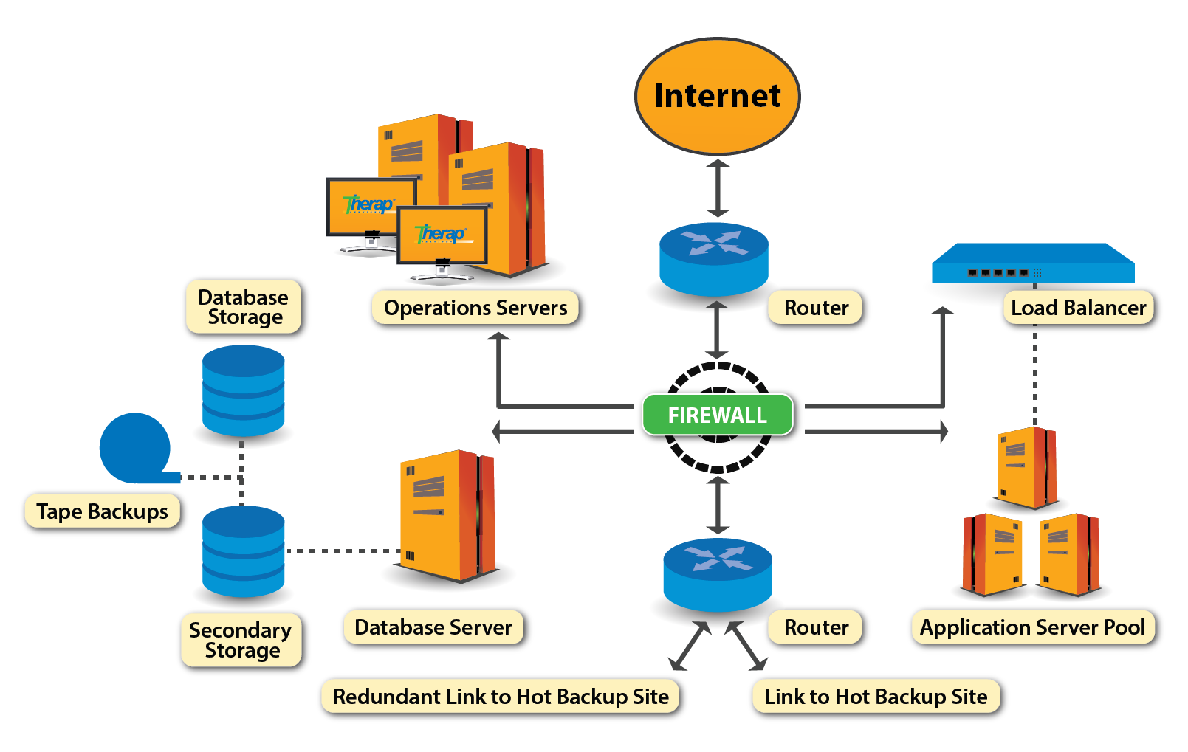
Infrastructure
© Copyright Therap Services, LLC. 2003 - 2014, All Rights Reserved. U.S. Patents #8281370, #8528056, #8613054, #8615790, #8739253

Slide 12
Infrastructure Security
Physical Controls
Procedural Controls
Site Access – Card/Physical keys, video monitoring
Environmental Redundancy – Dual power, UPS, generator
Infrastructure Redundancy – Highly Available Storage, RAID, multiple application servers, multiple links
System and Data Backups – Local + encrypted offsite
Inter-site Redundancy – Two sites, either can run full application suite
Operations User IDs – Created through approval process
Role-based Access Control – Access based on scope of staff member’s role
Change Management – Defined procedures for planning and executing changes to production environment
Disaster Recovery/Business Continuity – Ongoing process to identify and mitigate failure scenarios
Performance and Security Monitoring – Partner process to Logical/24x7 Operations
Application User IDs – Controlled by agency administrators
Logical Controls
Key Resource:
SANS Critical Security Controls
(aka, SANS Top 20)
Firewalls – Controlled access to and within Therap
Anti-Malware – Security of uploaded files
Load Balancers – Transparent user session mobility
Database Replication – Continuous data replication between sites
24x7x365 centralized logging and event capture
Vulnerability Assessments – Third party, self-directed
Vendor and subscription-based notifications
© Copyright Therap Services, LLC. 2003 - 2014, All Rights Reserved. U.S. Patents #8281370, #8528056, #8613054, #8615790, #8739253

Slide 13
Breaches: HHS Site http://www.hhs.gov/news/index.html
Therap’s solution to significant breaches of 2012
Backup tapes stored at hospital cannot be found and are presumed lost– 315,000 affected
Therap Manages backups. Equipment, tapes, servers , etc. are in secure environment
Unencrypted emails sent to employee’s unsecured email address -- 228,435 affected
Therap providers customers with Scomm a secure email system
Theft of laptop from employee’s vehicle– 116,506 affected
Therap system does not leave any data on hardware accessing system
Unauthorized access to e-PHI stored in database-105,646 affected
Therap provides a 100% audit trail of people accessing system
Hacking database stored on network server – 70,000 affected
Therap uses state of the industry technology to prevent hacking (Physical, Logical, and Procedural controls.

Slide 14
Contact:
Barry Pollack Therap Services, Regional Director
Barry.Pollack@TherapServices.net
386-212-3201

