Slide 1
Inclusion in America: Good, Bad and Trending
Tarren Bragdon, Researcher

Slide 2
Case History: 2006 to 2015
UCP realizes the need for a holistic, data-driven approach to measure what’s happening in the States and how that changes over time
UCP stands in the gap to provide real facts, historical context, and a roadmap for future inclusion through the Case and the Plan for Inclusion
Good politics – Rankings and sub-rankings
Good policy – Plan for Inclusion, inspiring advocates with proven reform solutions

Slide 3
Major Enhancements in 2014
Based on feedback and suggestions, UCP wanted to better measure health, safety and quality of life
National Core Indicators survey data incorporated
Added 14 new measures
Self direction
Health
Safety
Community Involvement
Relationships
Use federal functional definition
Vocation rehab – success, hours worked, retention
Removed 3 outdated measures

Slide 4
2015 Highlights
Top 10 - Best | Bottom 10 - Worst
Arizona Maryland Missouri New York Hawaii Colorado Minnesota Dist. of Columbia South Carolina Ohio | North Dakota Oklahoma Iowa Wyoming Idaho Illinois Montana Arkansas Texas Mississippi

Slide 5
The Good
32 States now meet the 80/80 Community standard. (compared to 14 in 2007 report)
As of 2013, 14 States have no state institutions isolating Americans.
10 States have only one institution each.
Since 1960, 220 of 354 State institutions have been closed. Still 134 remaining. 5 closed in past year. Another 13 projected to close by 2016.
2007 Ranking - only 9 states had no State institution, another 13 States had just one, 176 total State institutions open (in 2005).

Slide 6
The Good
42 States participate in the National Core Indicators with 29 reporting outcomes from 2014 survey, up from 19. (compared to just 24 in 2007 report)
Only 14 States were supporting a large share of families through family support. (compared to just 10 in 2007 report)
10 States report at least 10% of individuals using self-directed services (up from 6 last year)

Slide 7
The Bad
All States have room for improvement, but some have consistently remained at the bottom since 2007.
AR (#49), IL (#47), MS (#51) and TX (#50) primarily due to the scant resources dedicated to those in small or home-like settings. Also, MS and TX do not participate in NCI.
Just 8 states have at least one-third (33%) of individuals in competitive employment. 17 states met this standard in 2007 report.
High waiting lists for residential and community services
322,000 (44% growth to meet need), up from 317k
Only 16 states report no or small waiting list (<10% growth)
2007 Ranking- 138,000 wait list (32% growth)

Slide 8
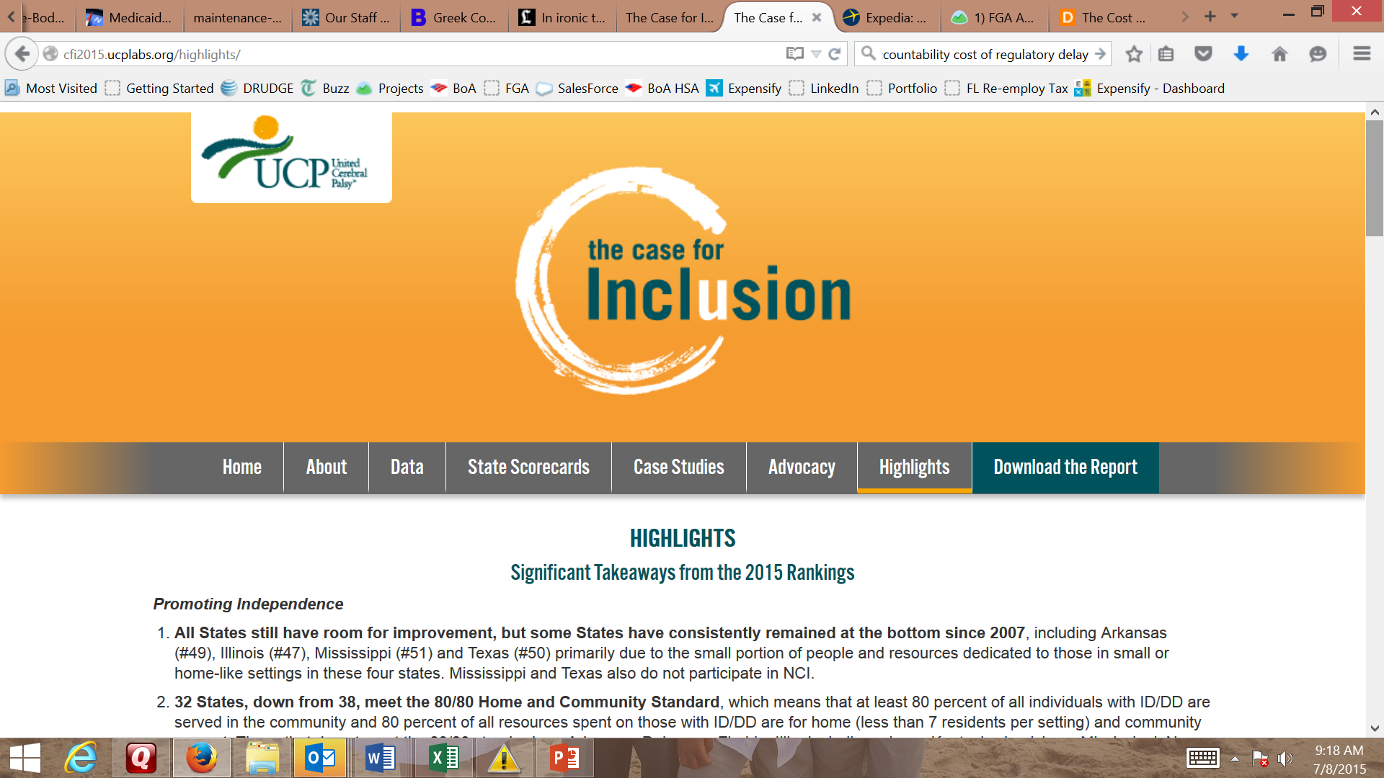

Slide 9
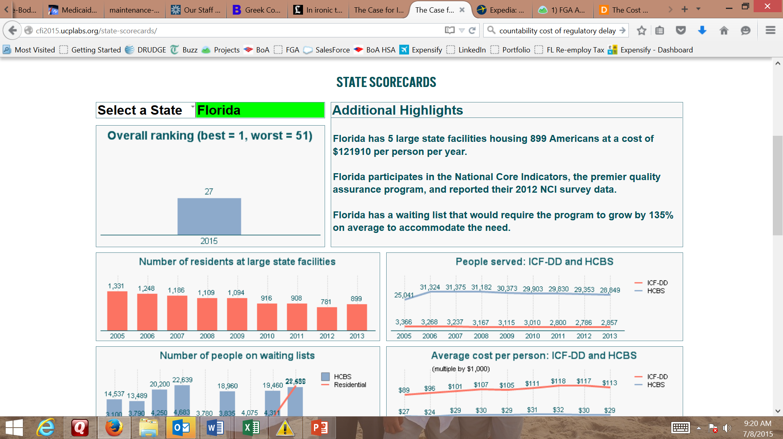
cfi.ucp.org Actionable: Facts, Context, History

Slide 11
cfi.ucp.org Actionable: Facts, Context, History

Slide 12
New Case Studies
1. Wait No More: A Detailed Strategy to Eliminate Your State’s Waiting List
Learn from how various States manage and publicize their waiting lists and then combine these lessons with a comprehensive and multi-year legislative strategy to end a waiting list
Model legislation to advance in your state
2. Transitions: The Proven Parenting and Programs to Help Kids with Intellectual and Developmental Disabilities Become Happy, Productive, Engaged Adults
Four key outcomes
Attend postsecondary education
Work
Live independently
See friends at least weekly
Evidence-based practices that most impact successful transition

