Slide 1
Technical questions? Please contact
Ben Voynick:
bvoynick@ucp.org
(202) 973-7131 During the presentation, please direct questions to Anita Porco via Fuze text chat
There will also be a Q&A at the end of the presentation
Audio lines are muted during the presentation. Please use text chat.
Windows: Panel at lower left.
Mac: Open using bubble at upper left

Slide 2
Business Planning for Mission Advancement United Cerebral Palsy
July 30, 2013
with Lester Olmstead-Rose and Heather Gowdy

Slide 3
Agenda
Opening
Strategy and Planning
Business Model
The Market
Choosing a Sustainable Strategy: Evaluating Options
Designing an Effective Process
Questions and Discussion

Slide 4
Poll Questions

Slide 5
Has your organization engaged in business planning in the last five years?
Yes
No

Slide 6
For those who have: what was the focus of the business plan?
A new program
A new or significant partnership
Launch of a “social enterprise”
Significant organizational growth

Slide 7
Strategy and Planning

Slide 8
What is Strategy?
A coordinated set of actions designed to create and sustain a competitive advantage in achieving a nonprofit’s mission.

Slide 9
Strategic Planning
Strategic planning is, at its best, the process of considering and making strategic decisions.

Slide 10
Business Planning
Business planning is the process of determining the parameters of an economically and operationally successful undertaking.

Slide 11
Strategic vs. Business Planning
Strategic Planning
Business Planning
Develop organizational responses to opportunities and challenges
Determine a means to increase mission impact
Articulate a strategy
Define a program model
Confirm the need for a business model change
Test the economic logic and operational feasibility of a proposed response
Test the assumptions that prove the change is feasible
Test and elaborate on the core elements of the strategy
Show how the model will be viable
Describe the how and why of success

Slide 12
Strategic vs. Business Planning
Business Planning (as needed)
Strategy Formation (as needed)
Traditional Strategic Planning (at least every three years)
Time

Slide 13
When to Consider Business Planning
Significant change to business model
Launch of program, partnership, or entity
Growth strategy
Need information for go/no-go decision
Need to show that venture is compelling, viable, worthy of support
Need details to plan for implementation

Slide 14
Will your organization be considering any of the following in the next 1-2 years?
A new program
A new or significant partnership
Launch of a social enterprise
Significant organizational growth
None of the above

Slide 15
Business Planning: DARE² Succeed
Design
Research
Evaluate
Elaborate
Assess

Slide 16
Current Business Model

Slide 17
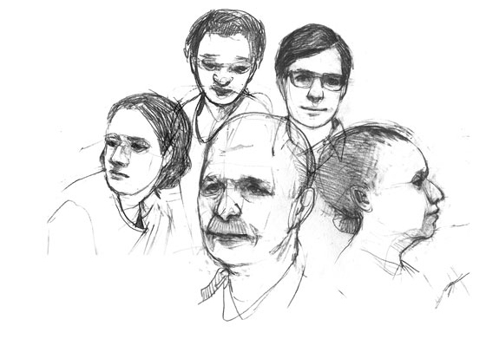
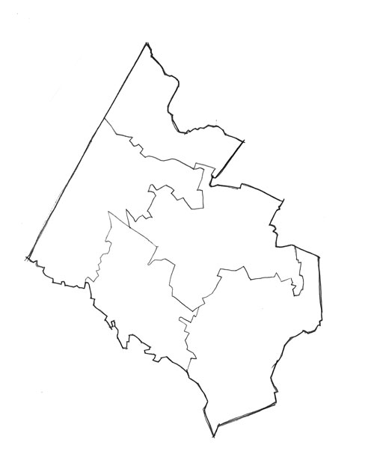
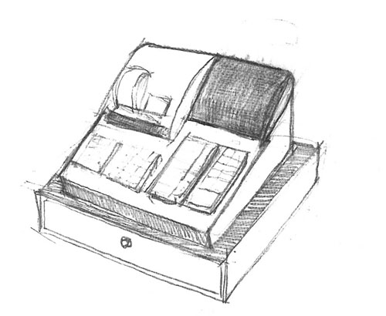
Business Model
Who
How
Where
What

Slide 18
Examine Your Scope

Slide 19
Assess Your Economic Logic

Slide 20
Evaluate Your Organizational Capacity

Slide 21
The Market

Slide 22
Understand Trends

Slide 23
Understand Competitors

Slide 24
Identify Competitive Advantage

Slide 25
Understand Need and Demand

Slide 26
Evaluate & Elaborate

Slide 27
Business Planning: DARE² Succeed
Design
Research
Evaluate
Elaborate
Assess

Slide 28
Consider…
Operational implications
Financial implications
Risk factors

Slide 29
Operational implications

Slide 30
Financial implications

Slide 31
Assumptions

Slide 32
Goals
Identify and test important assumptions, including assumptions about key economic drivers
Economic drivers: those variables that most influence the scale and financial sustainability of an undertaking
Demonstrate that the financial elements of the venture’s success are well understood by the team spearheading the effort

Slide 33
Building Financial Projections
Assumptions
Overarching
Related to drivers
Financial Model
Test Scenarios
Financial Statements
Budget
Cash Flows
Finalize choices
Balance Sheet

Slide 34
Risk
and risk mitigation

Slide 35
Typical Contents
Executive Summary
Mission, Vision, and Desired Impact
The Program, Organization, or Initiative
The Market
Management and Operations
Key Collaborative Relationships / Partnership Model
Marketing Strategy
Financial Projections and Fund Development
Evaluation and Measurement of Impact
Risks and Risk Mitigation
Appendices

Slide 36
Designing an Effective Process

Slide 37
Business Planning: DARE² Succeed
Design
Research
Evaluate
Elaborate
Assess

Slide 38
The Planning Team
Many to consult, small group to lead
ED/CEO
Top financial manager
Other senior / specialized staff
Board members, other managers / staff
Representatives from each partner
Future leader

Slide 39
Six Questions
What is the focus of the plan?
What is the strategic intent of the initiative?
What questions need to be answered?
What information will be needed?
Who is the audience for the plan?
Who will approve final decisions and document?

Slide 40
Table of Contents
as a planning tool

Slide 41
Questions and Discussion
41

Slide 42
Thank you.
gowdy@lapiana.org
olmstead-rose@lapiana.org
lapiana.org
Notes:
42

